Slide 1
EDA Project
By: Abdulrahman Alrifae

Slide 2
The Metropolitan Transportation Authority (MTA)
(MTA) is North America's largest transportation network, serving a population of 15.3
MTA shows there is many shutdowns, using the data set will help find the problem and try to solve it.
MTA during Covid-19 lost a lot of money, Finance the MTA through business such as scooter.

Slide 3
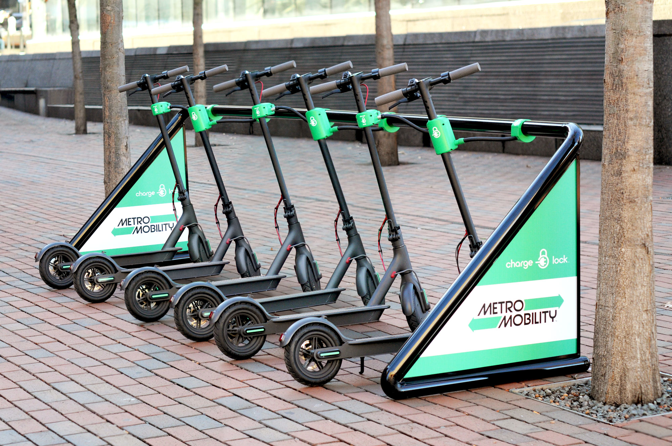
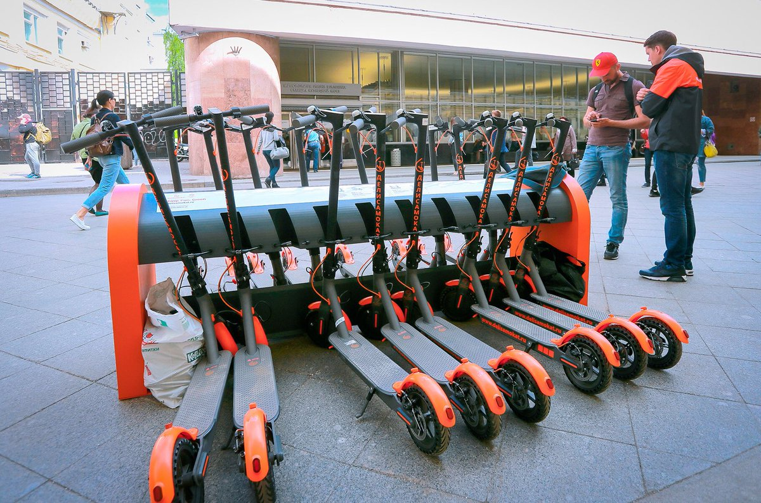
Scooter Station

Slide 4
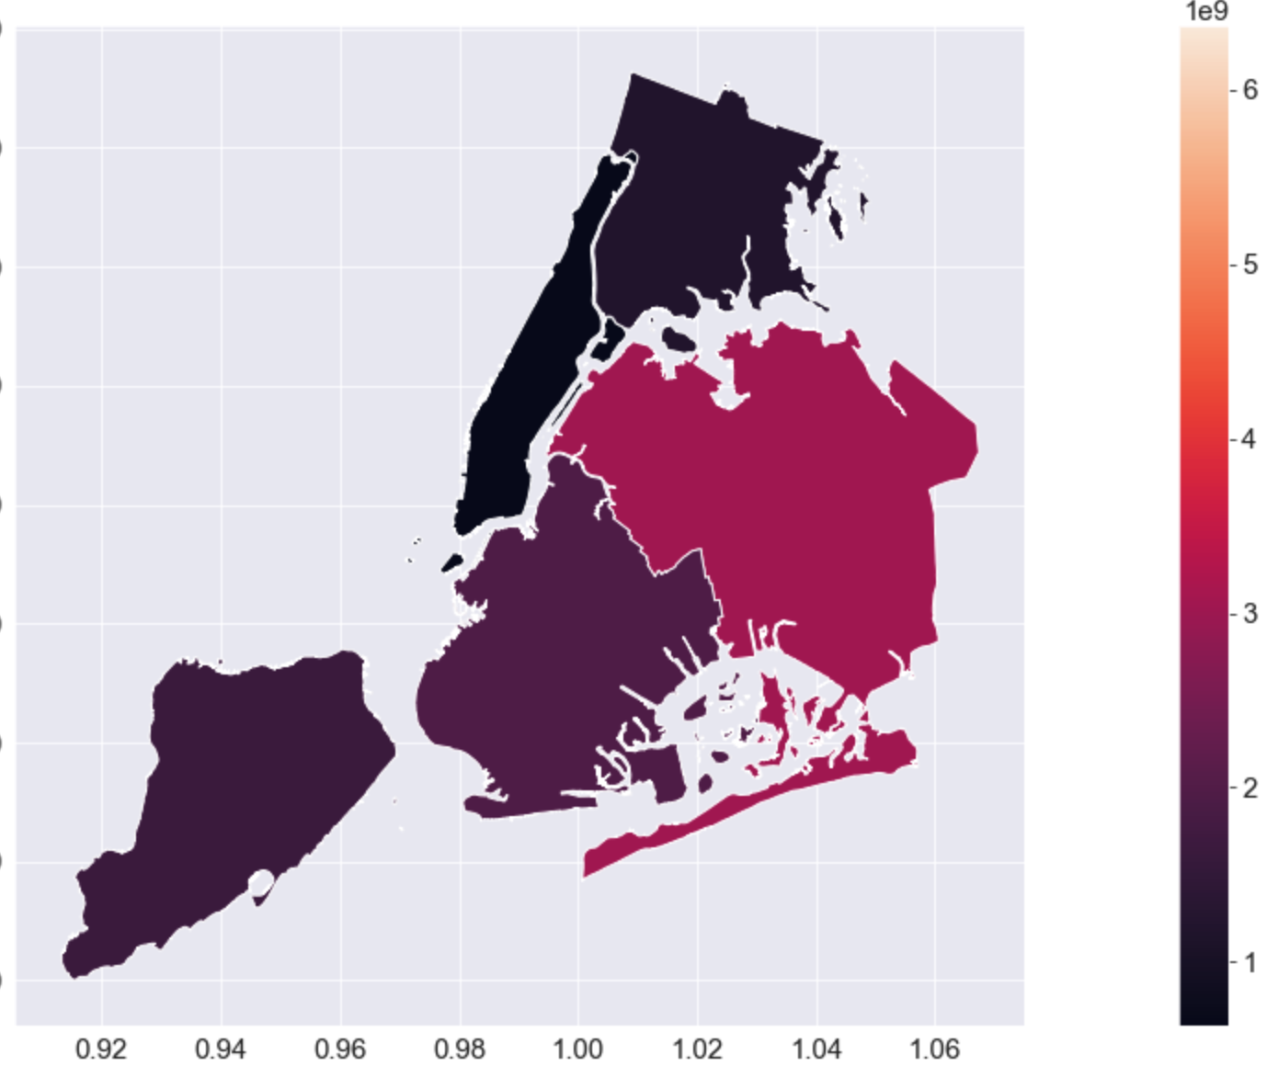
Heat Map of NYC

Slide 5
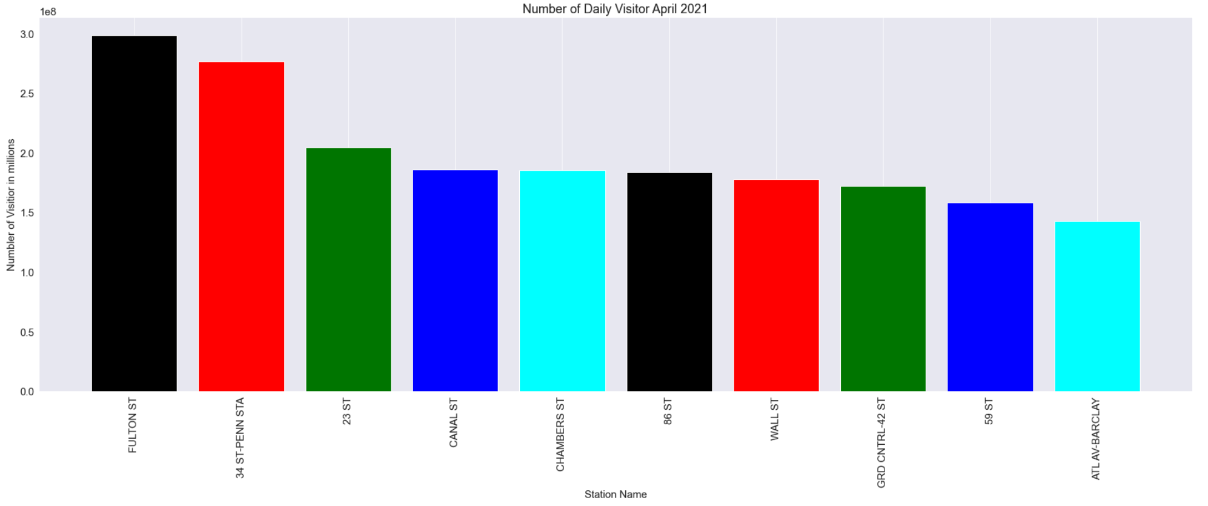
April 2021

Slide 6
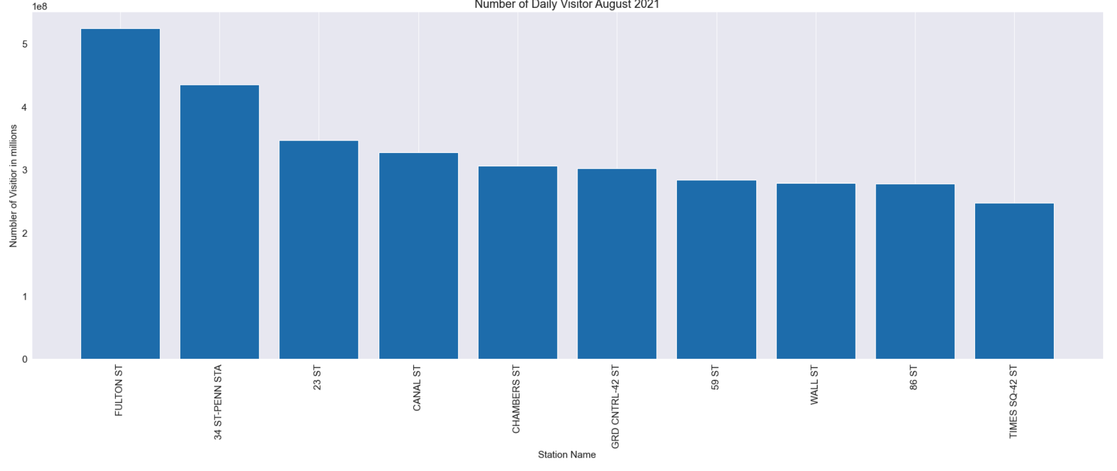
August 2021

Slide 7
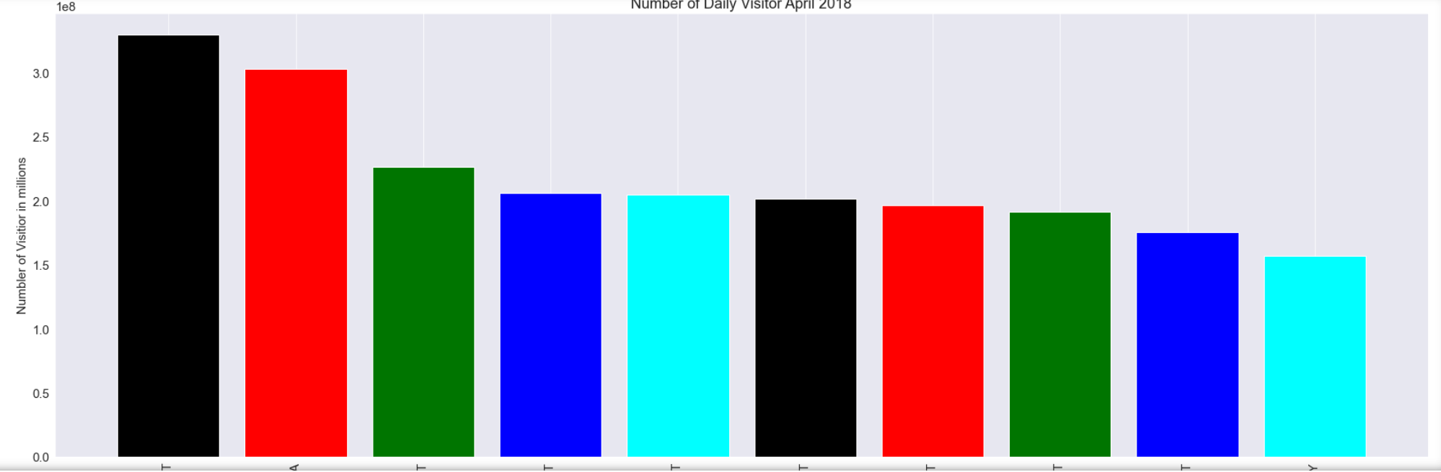
April 2018

Slide 8
August 2018

Slide 9
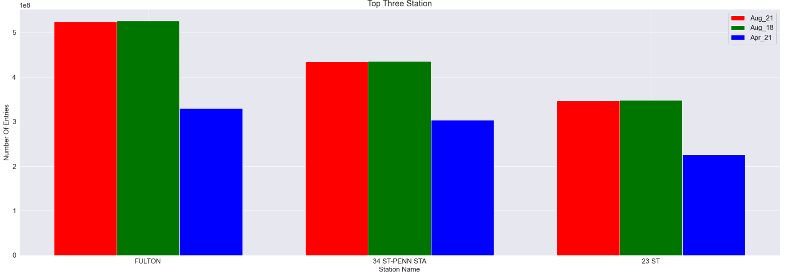
All The Months

Slide 10
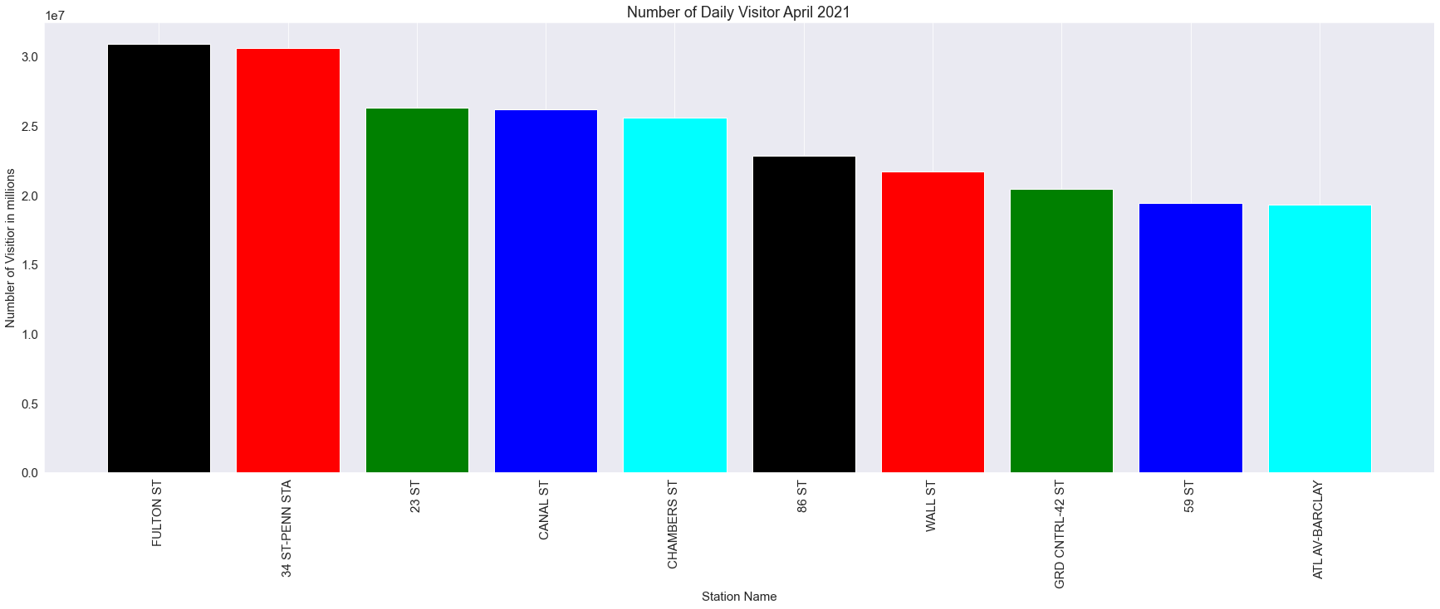
Mean of the daily visitor
If 0.5% of the people rent the scoter from one station, the total cost will be around 5.5 Million

